Slide 1

Containment
Solutions

Slide 2
Cooling Efficiency Solutions
Passive Thermal Containment
Blanking Panels
Foam, Skirts and Covers
Raised Floor Grommets
Brush Seal Solutions
Under-Floor Baffle System
Containment Curtains, Panels and Doors
Capped Aisles
Dynamic Airflow Management
In-Rack Airflow Delivery and Distribution
Under-Floor and Overhead Air Movers
Intelligent Airflow Distribution and Management
Pressure-Managed Heat Extraction
Notes:
Print4 Reseller Presentation
2

Slide 3
Cooling Efficiency Solutions
Passive Thermal Containment
Aid data center airflow and cooling
Prevents by-pass airflow and mixing
Considered “Best Practices” products
High Value for lower cost
Typically used in conjunction with larger efficiency initiatives
Can be part of Utility Incentive projects
Containment Solutions typically require design and are custom to each application. Applies to HAC and CAC
CRAC Duct and Extender Kits
Modular Design, easy to assemble, non-intrusive to drop ceiling, access door for filters. Ships flat, assembles on-site
Blanking Panels
Foam, Skirts and Covers
Raised Floor Grommets
Brush Seal Solutions
Under-Floor Baffle System
Containment Curtains,
Panels and Doors
Capped Aisles
Notes:
Print4 Reseller Presentation
3

Slide 4
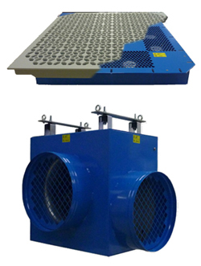

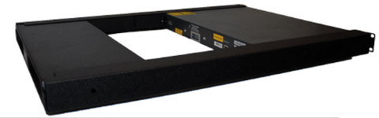
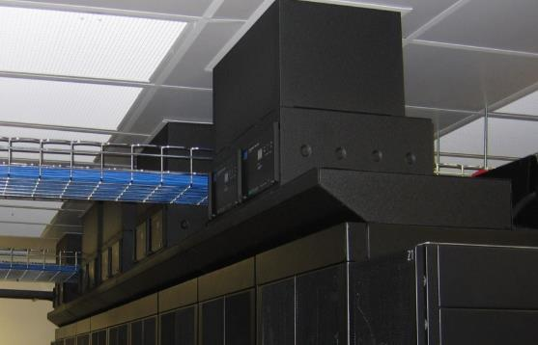
Cooling Efficiency Solutions
Dynamic Airflow Management
In-Rack Airflow Delivery
and Distribution
Under-Floor and Overhead
Air Movers
Intelligent Airflow Distribution
and Management
Pressure-Managed Heat Extraction
Notes:
Print4 Reseller Presentation
4

Slide 5
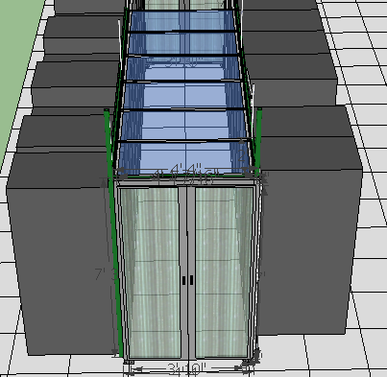
Containment Solutions Hot and Cold Aisles
Design Capabilities
Aisle end showing door design where racks do not line up with one another
Vertical Panels with twin-wall inserts used for gaps in rows, irregular alignment, and above racks
Drop-Away Panels installed on tops of racks to cap the aisle
Notes:
Print4 Reseller Presentation
5

Slide 6
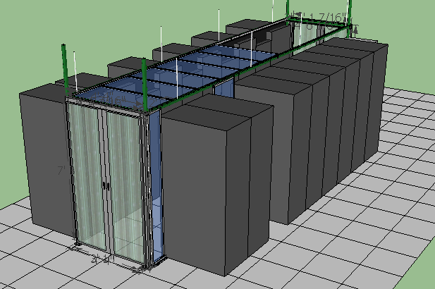
Containment Solutions for Hot and Cold Aisles
Design Capabilities
Vertical Panel creates barrier for empty rack location
Vertical Panel to even out aisle end
Notes:
Print4 Reseller Presentation
6

Slide 7
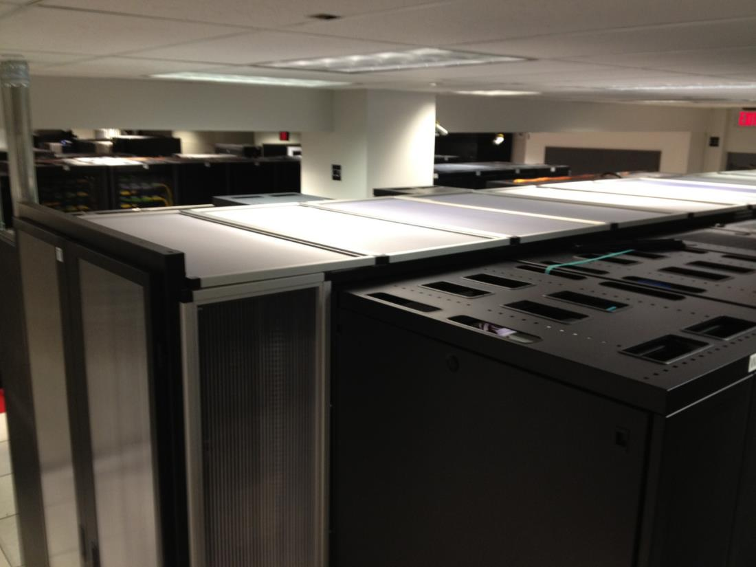
Containment Solutions for Hot and Cold Aisles
Finished Solution
Notes:
Print4 Reseller Presentation
7

Slide 8
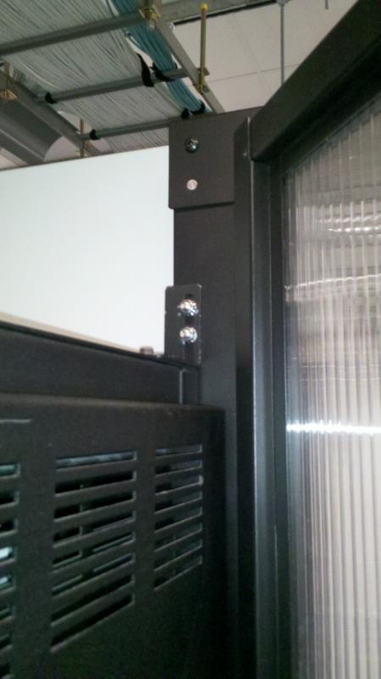
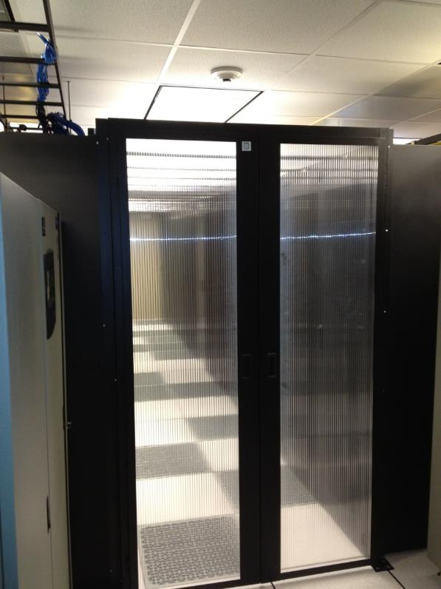
Containment Solutions for Hot and Cold Aisles
Aisle End Swing Doors
Detail of Swing Door mounting
Attachment to
row-end racks
Notes:
Print4 Reseller Presentation
8

Slide 9
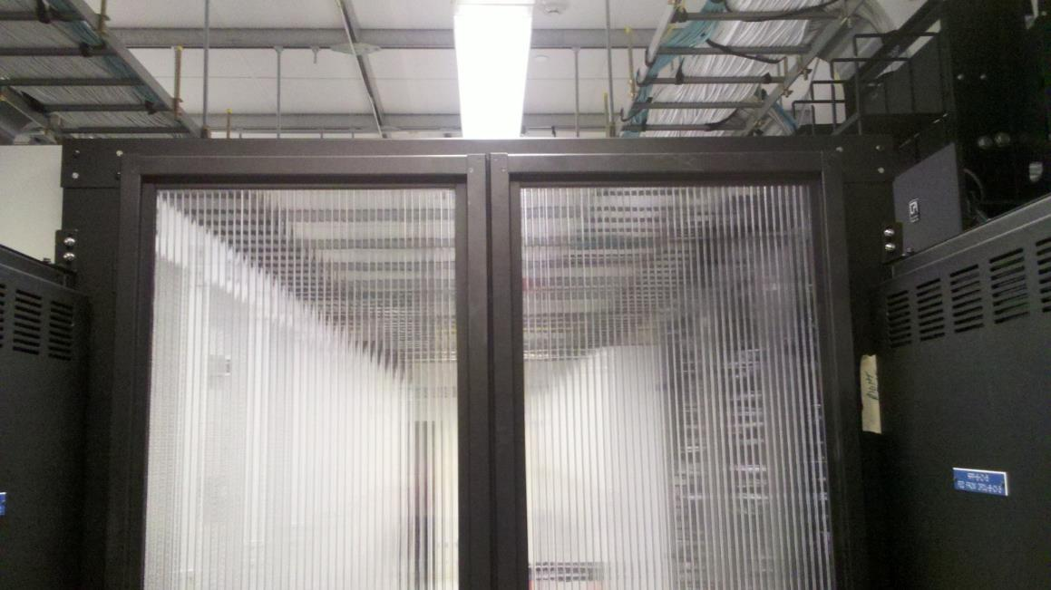
Containment Solutions for Hot and Cold Aisles
Custom Swing Doors
Low-Profile Aisle End Swing Doors installed in gap between PDU and rack
Notes:
Print4 Reseller Presentation
9

Slide 10
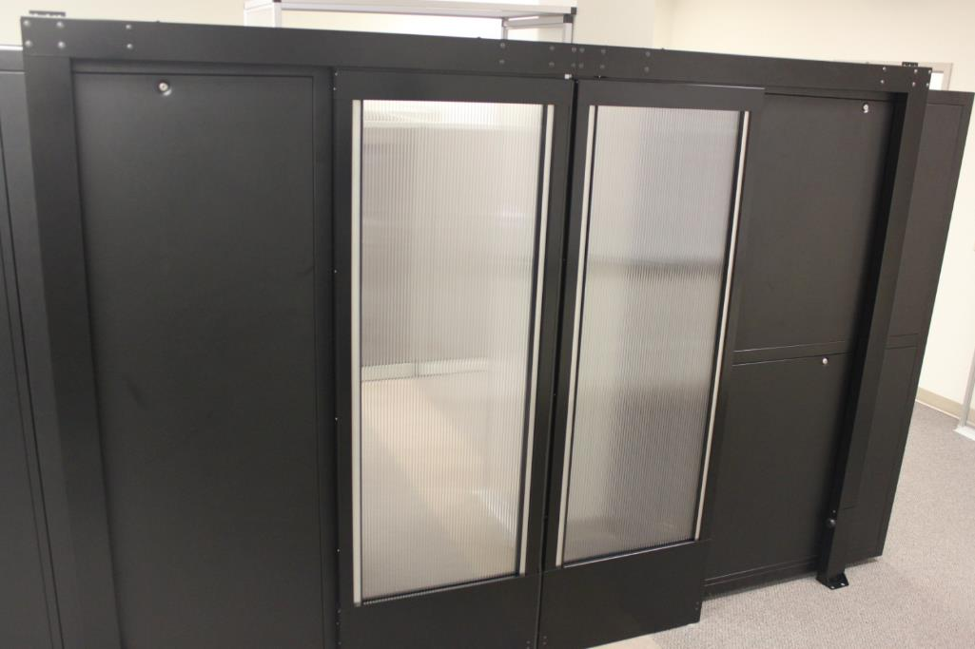
Containment Solutions for Hot and Cold Aisles
Aisle End Sliding Doors
Sliding Door attached to row-end racks
Notes:
Print4 Reseller Presentation
10

Slide 11
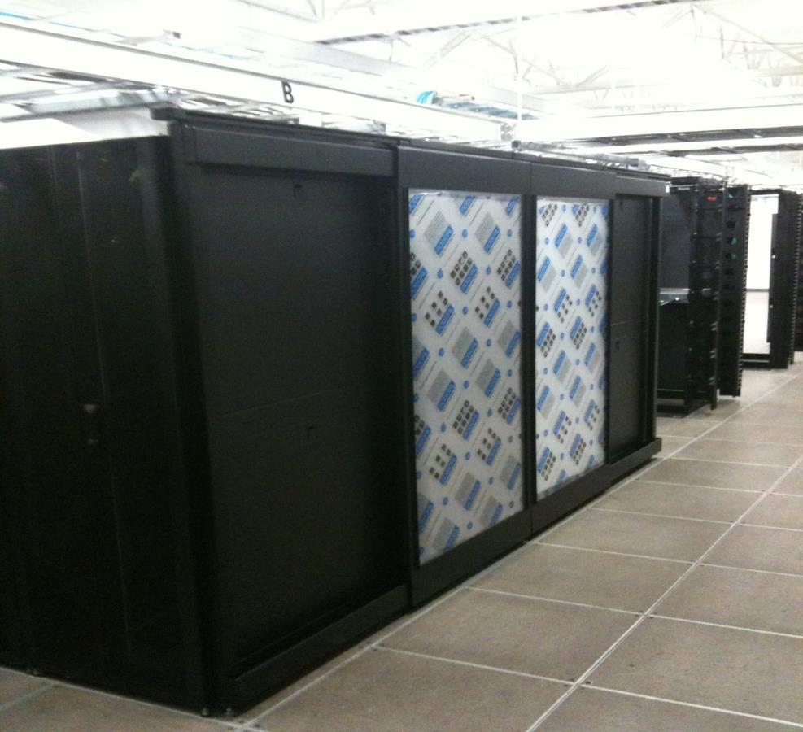
Containment Solutions for Hot and Cold Aisles
Aisle End Sliding Doors
Notes:
Print4 Reseller Presentation
11

Slide 12
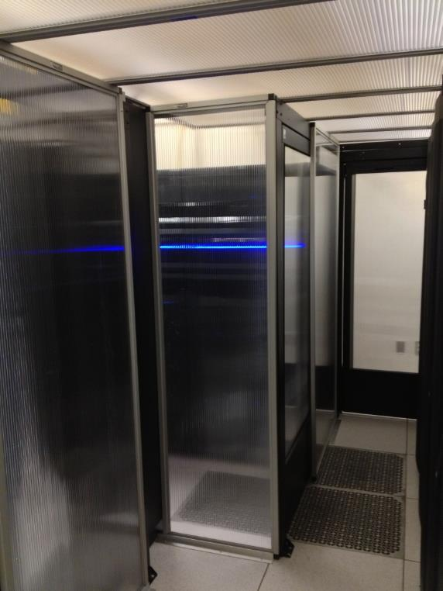
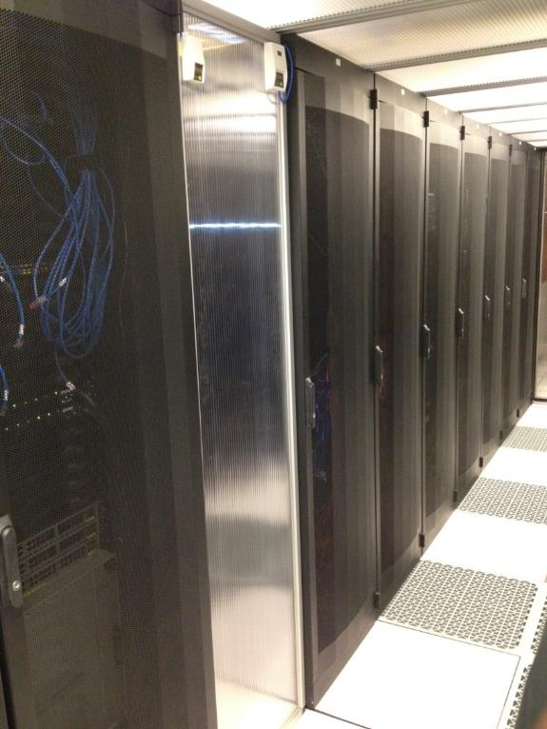
Containment Solutions for Hot and Cold Aisles Vertical and Custom Panels
Vertical Panels Installed in contained aisle
along with Single-Wide Door
Notes:
Print4 Reseller Presentation
12

Slide 13
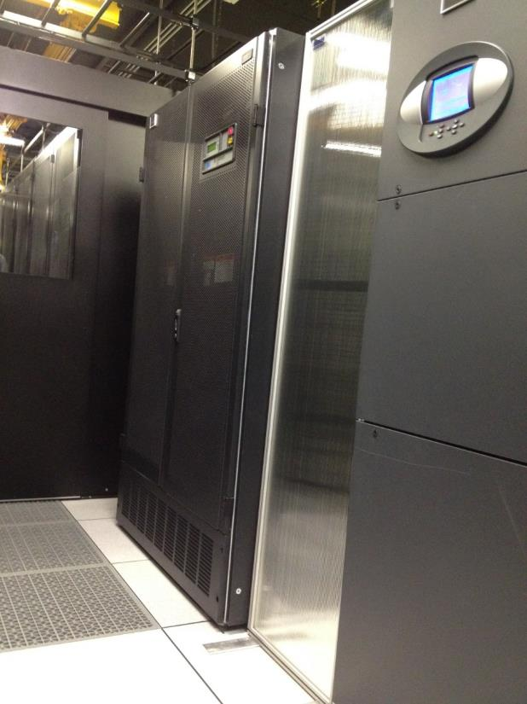
Containment Solutions for Hot and Cold Aisles
Vertical and Custom Panels
Free-Standing Vertical Panel with feet
Notes:
Print4 Reseller Presentation
13

Slide 14
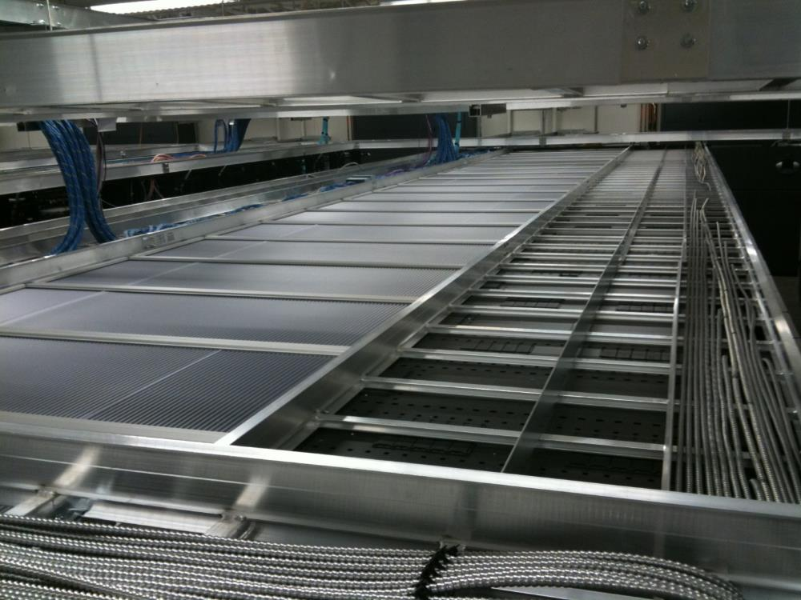
Containment Solutions for Hot and Cold Aisles
Capped Aisles
Overhead photo of “Drop-Away” Panels in custom frames
Notes:
Print4 Reseller Presentation
14

Slide 15
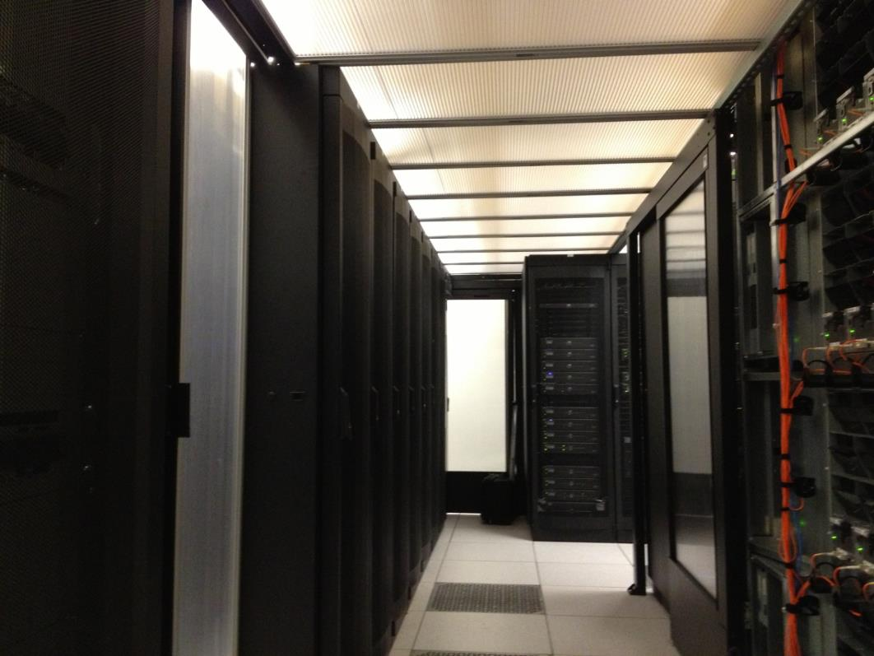
Containment Solutions for Hot and Cold Aisles Capped Aisles
“Drop-Away” Panels and Single Sliding Door
Notes:
Print4 Reseller Presentation
15

Slide 16
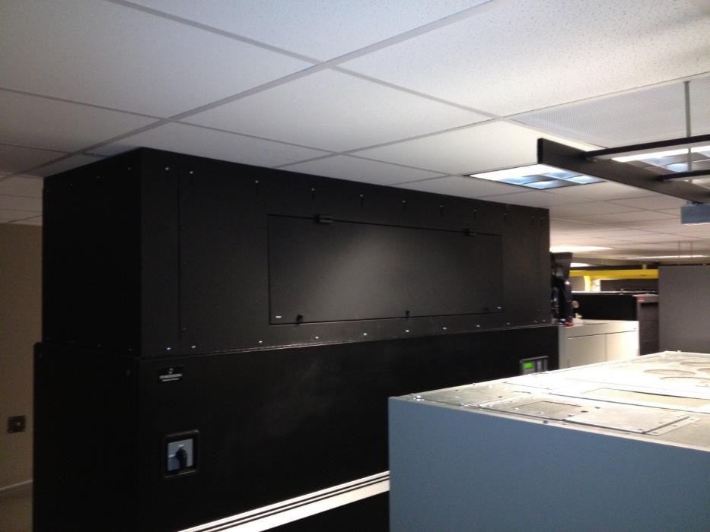
Containment Solutions for Hot and Cold Aisles
CRAC/CRAH Hoods
DCIM CRAC Hood used to direct-couple to overhead plenum
Notes:
Print4 Reseller Presentation
16

Slide 17
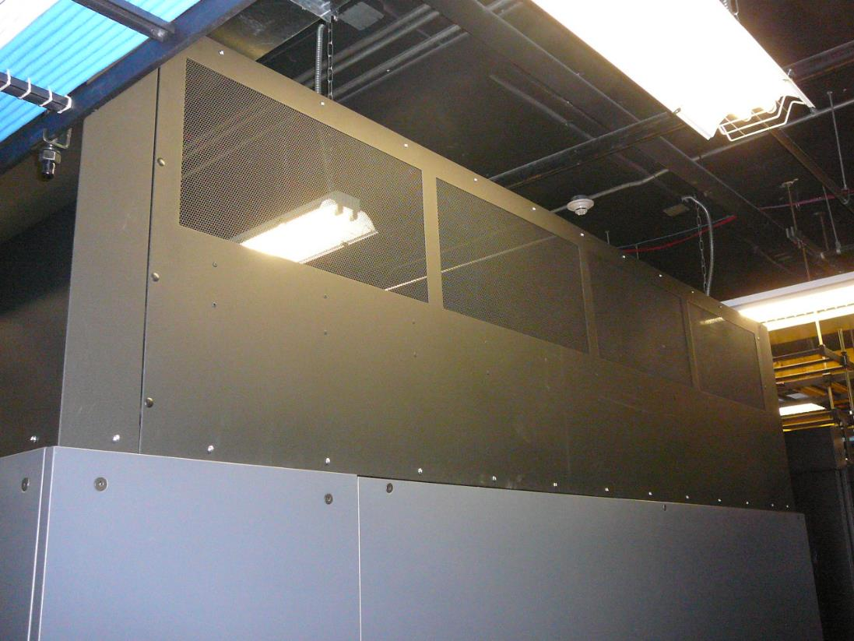
Containment Solutions for Hot and Cold Aisles
CRAC/CRAH Hoods
Custom Duct Designs
Notes:
Print4 Reseller Presentation
17

Slide 18
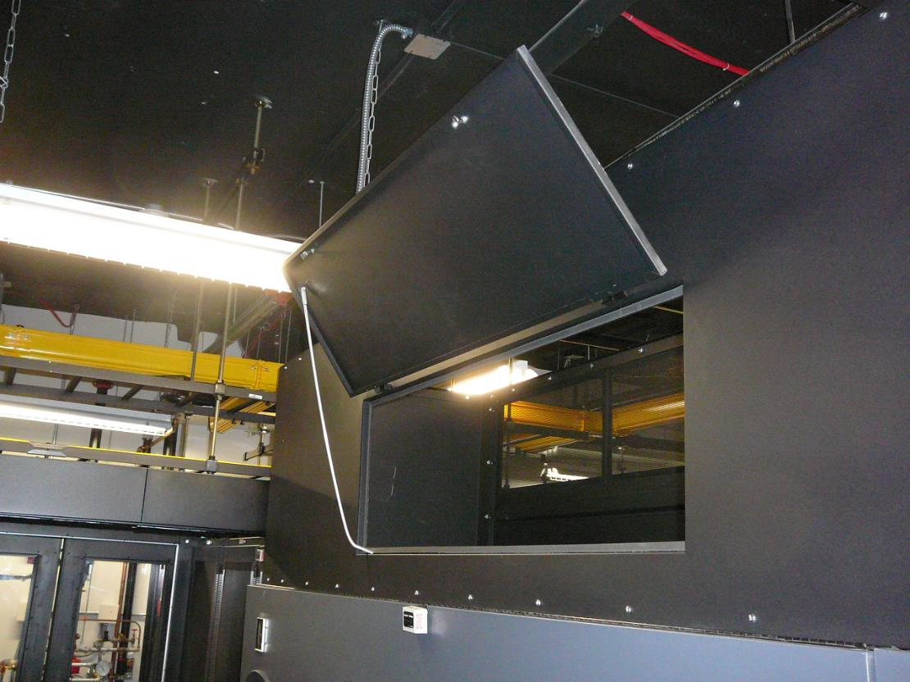
Containment Solutions for Hot and Cold Aisles CRAC/CRAH Hoods
Filter Access Door
Notes:
Print4 Reseller Presentation
18

Slide 19
Containment Solutions
Capabilities
Thermal/Capacity Assessments
CFD Modeling
Containment Design
Standard and Custom Products
Monitoring and Alerting
Fabrication
Turnkey Installation and Logistics
Notes:
Print4 Reseller Presentation
19

